Slide 1
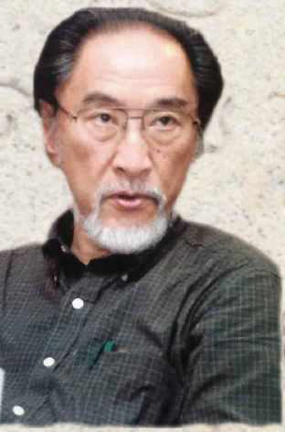
Vasu Renganathan University of Pennsylvania
Exploring Inter-textuality between Medieval Tamil Inscriptions and Bhakti literature
Textual traditions of medieval Bhakti poems and Tamil Inscriptions
Use of medieval Tamil in inscriptions
Adaptations of Prosodic poems in Inscriptions
Evolution of modern ritual traditions and inscriptional sources
Patiyam pāṭutal – link between medieval textual tradition and inscriptional Tamil
International Symposium
South Indian Epigraphy and Art History
Institut National d’Histoire de l’Art,
12-13 October, 2017
In Memory of Professor Noboru Karashima

Slide 2
Establishment of Mūvāyira Viḷākam, ‘3,000 Regions of Thillai’ SII 8. 43.6
“…all the proceedings of the land mass covering the eastern side of the town can be owned and officially documented under the name of Thillai Mūvāyira Viḷākam ‘3000 regions of Thillai’. We hereby authorize them to get it inscribed in the sacred building…”

Slide 3
Appointment of 48 Piṭārarkaḷ and the custom of tiruppatiyam viṇṇappañceyyal
…rājarāja tēvarkku yāṇṭu irupattoṉpatāvatu varai uṭaiyār rājarājīsvarasrī uṭaiyārkkut tiruppatiyam viṇṇappañceyya uṭaiyār rārājatēvar kuṭutta piṭārarkaḷ nāṟpatteṇmarum ivarkaḷilē nilaiyāy uṭukkai vācippāṉ oruvaṉum ivarkaḷilē koṭṭimattaḷam vācippāṉ oruvaṉum āka aimpatiṉmarukkuppērāl nicatam nellu mukkuṟuṇi… (S.I.I.2 No. 65).
King Rajaraja Devar’s order in his 29th regnal year is hereby to perform the Tiruppatiyam to Rajarajiisvarasri Udaiyar. All of the 48 men [piṭārarkaḷ] who perform the Tiruppatiyam, as well as the one who plays the hand drum and the one who plays the stick drum, totalling 50 people, must be offered three quarters of the paddy.

Slide 4
Perpetual establishments for Tiruppatiyam viṇṇappañceyyal and the appointment of Piṭārarkaḷ
Ivarkaḷil cettārkkum aṉātēcam poṉārkkuntalaimāṟu avvavarkku aṭutta muṟai kaṭavār annelluppeṟṟut tiruppatiyam viṇṇappañceyyavum avvavarkku aṭutta muṟai kaṭavār tāntām yogyarī allātu viṭil yogyarāyiruppārai āḷiṭṭut tiruppatiyam viṇṇappañceyvittu annelluppeṟavum avvavarkku aṭutta muṟai kaṭavārinṟiyoḻiyil anta niyāyattāre yogyarāyiruppāraittiruppatiyam ‘Viṇṇappañceyya iṭṭu iṭṭa avaṉe avvavar peṟumpaṭi nellup peṟavum āka ippaṭi uṭaiyār srīrājarājatēvar tiruvāymoḻintaruḷiṉapaṭi kallil veṭṭiyatu. (S.I.I.2 No. 65.)
Among these, aside from those who are dead and those who have left the town, subsequent generations of people who chant Tamil Śaivā hymns should be offered the aforementioned amount of paddy. In the case of a lack of subsequent generations capable of [chanting Tamil Śaivā hymns], the people in charge should appoint those who are able to chant hymns and offer them the same amount of paddy. This is the writing made on stone by the order of Udaiyar Sri Raja Raja Tevar.

Slide 7
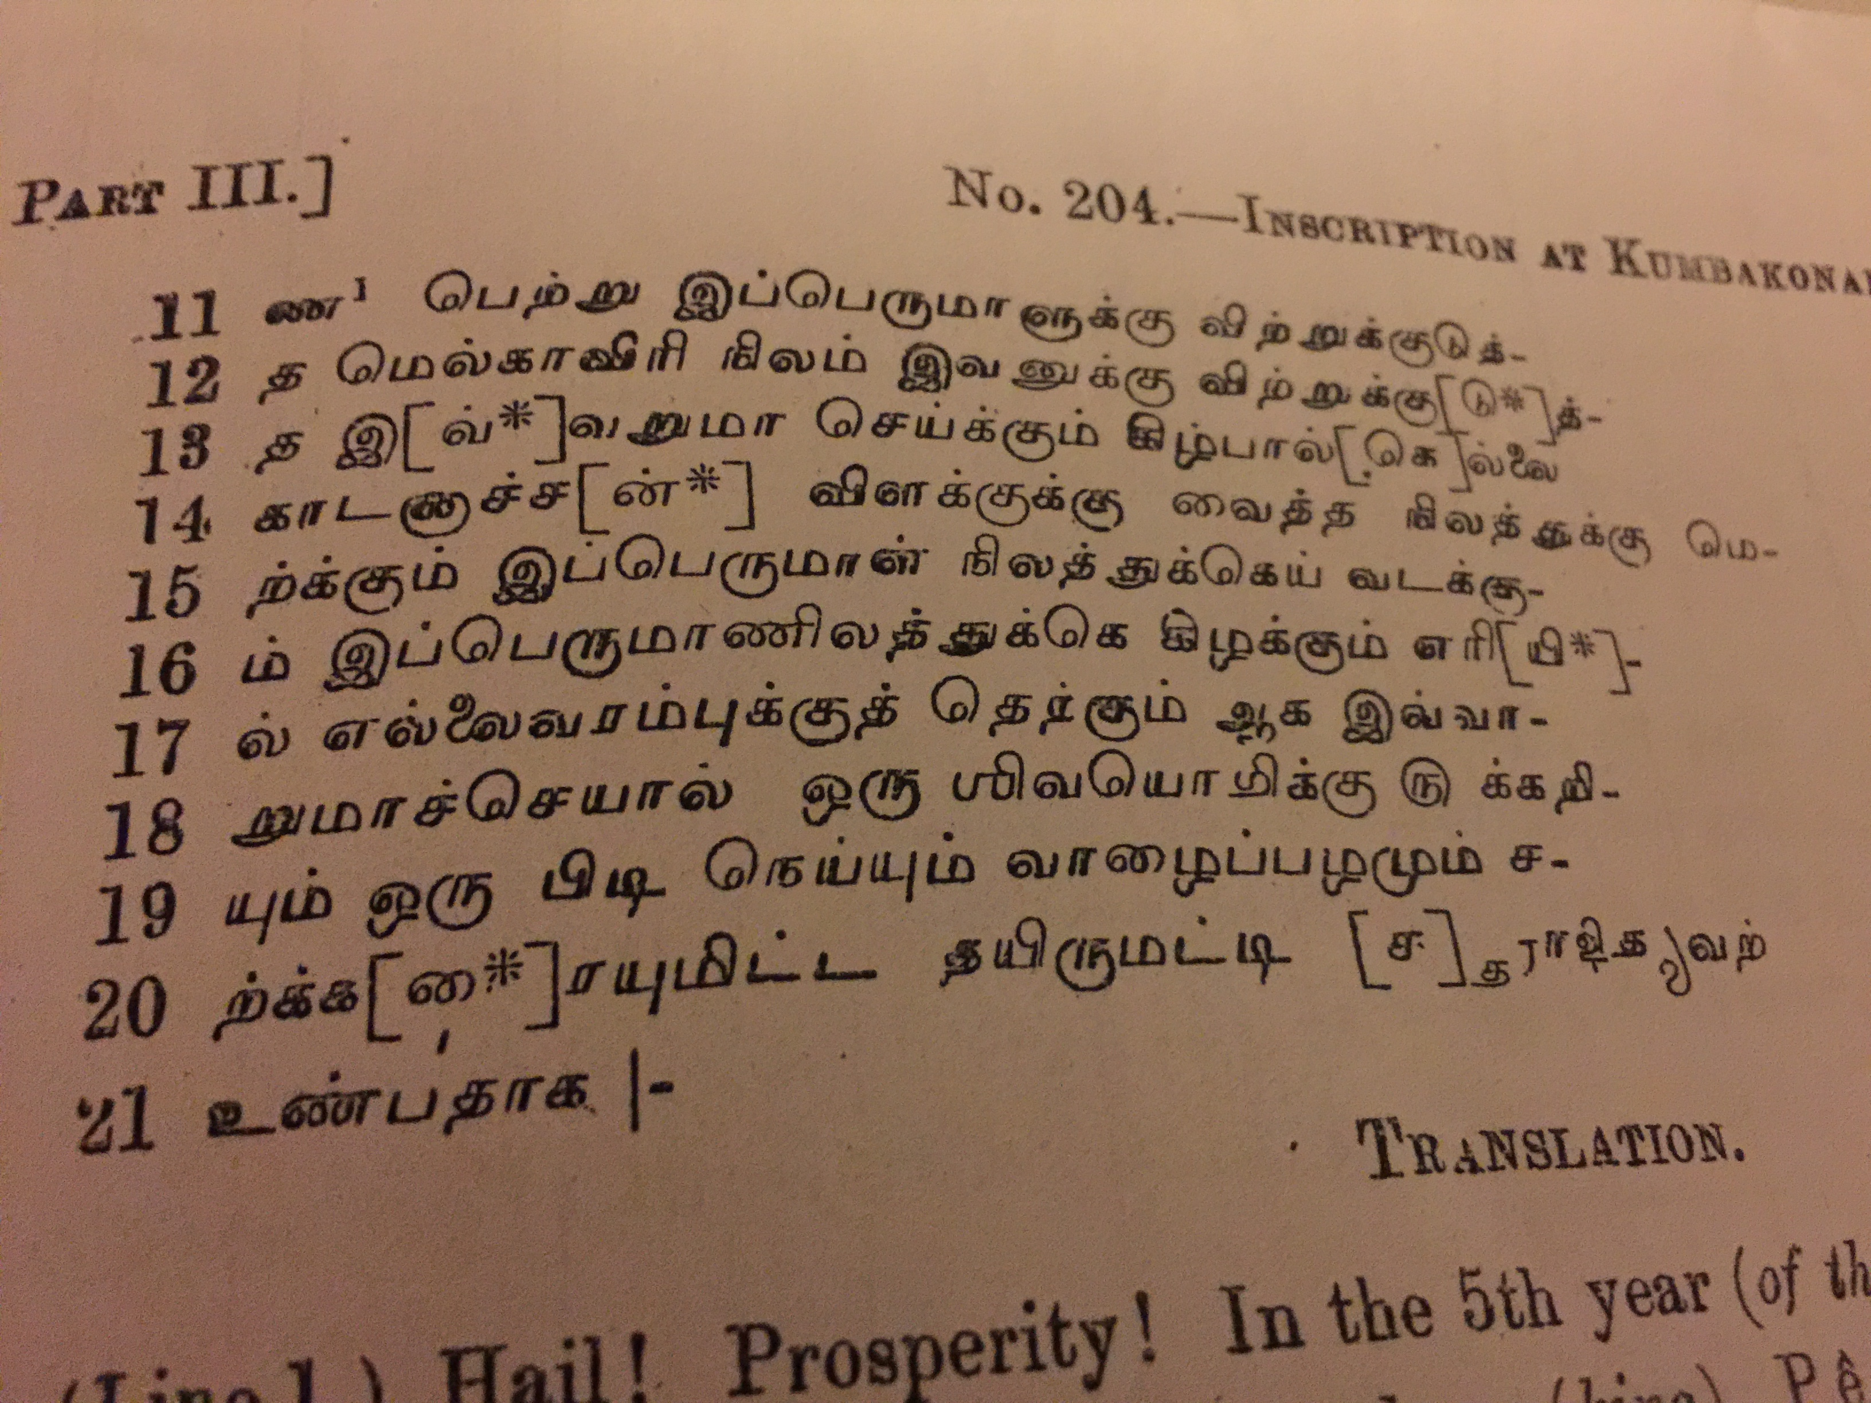

Slide 9
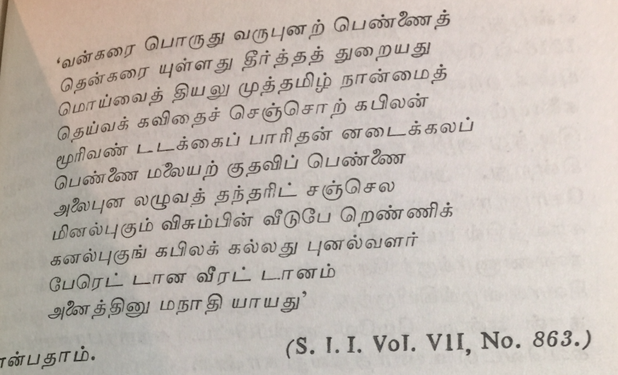
Reference to Sangam Tamil as Muttamiḻ

Slide 10
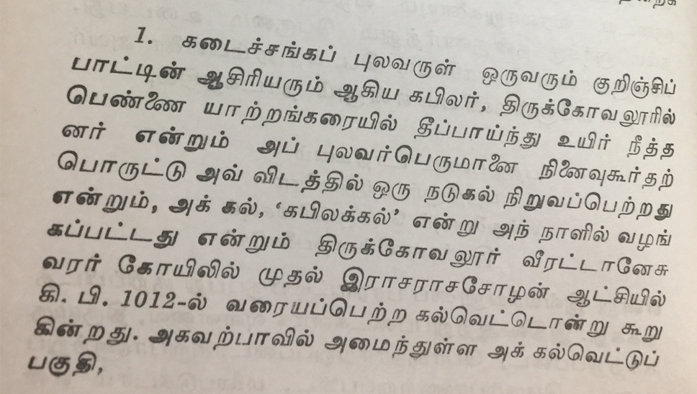

Slide 11
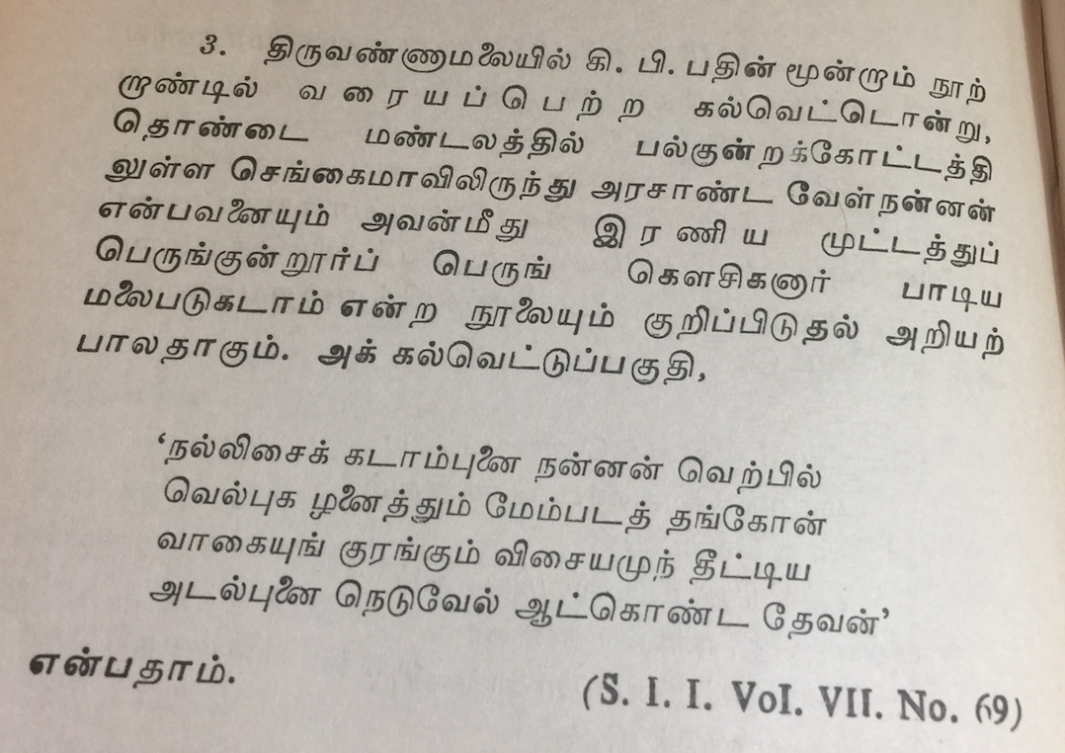

Slide 12
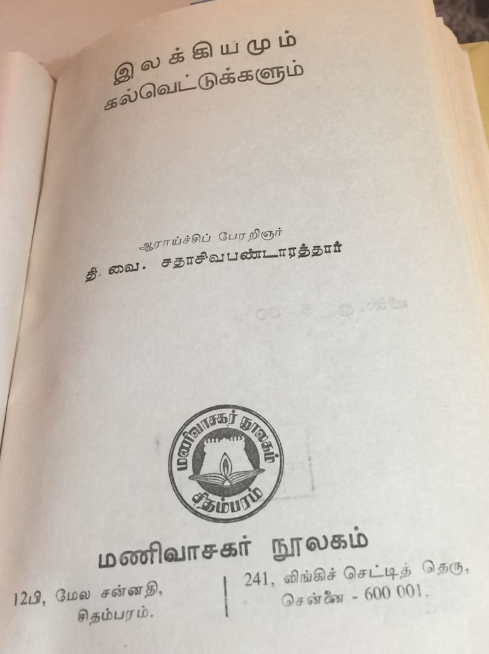

Slide 13
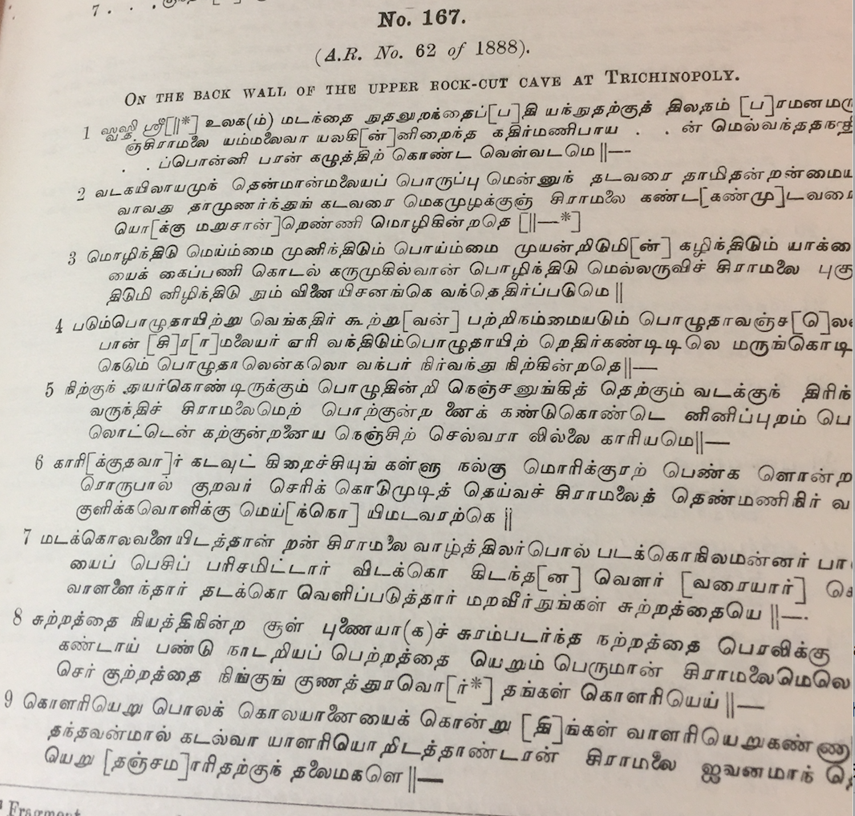
Medieval poem composed on the Cirāmalai temple deity
Poem without prosody but written in inscriptional style!
S.I.I. IV

Slide 14
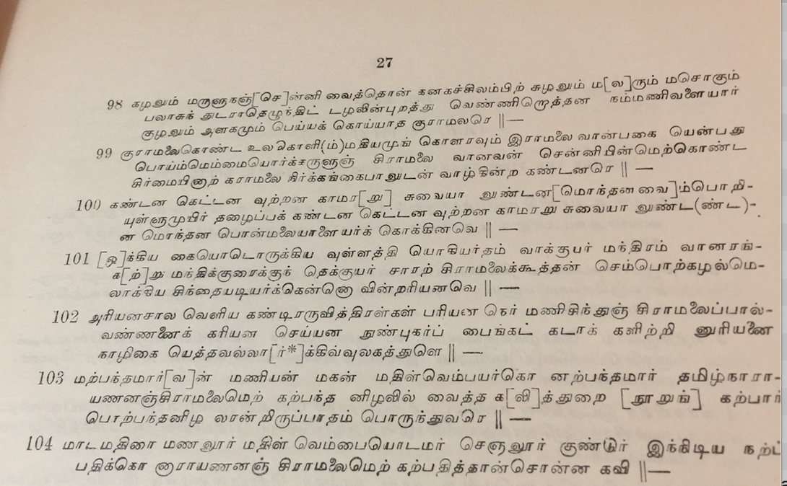
cirāmalai mēl kalpatittāṉ coṉṉa kavi
‘poem uttered by the scribe on
Cirāmalai’

Slide 16
Diverse doctrines: the textual traditions of inscriptions and medieval poems
Sanskrit, along with those from diverse other regions, such as the Kuccarar, Āriyar, Kōcalar, Koṅkaṇar, Vaccirar, Kāciyar, Cōṉakar and Vantiyar.
Nāl vētat tarumaṟaiyo raivveḻvi yāṟaṅkamuṭaṉ ciṟappa varuntamiḻu māriyamu maṟu camaiyat taṟa neṟiyun tiruntu maṉuṉeṟiyun tiṟampātu taḻaittōṅkak kuccararumāriyarum kōcalaruṅ koṅkaṇarum vacciraruṅ kāciyaru māttararu....rumaṉaruñ cōṉaka vantiyaru mutalāya virunila māmuṭi vēnta riṟaiñci niṉṟu tiṟaikāṭṭavum. (S.I.I.5. No. 459: 4)
Let the four Vēdas prosper, with all five types of fire ritual (Vēḷvi) in order; [let] the precious Tamil along with Āryam and other religious doctrines such as Manu’s prosper without fail. The kings of the Kuccarars, Āriyars, Kōcalars, Koṅkaṇars, Vaccirars, Kāciyars, Cōṉakars and Vantiyars, who belong to two regions, should also achieve great prosperity and richness.
It can be inferred from this inscription that the religious rituals of diverse doctrines were treated equally during the medieval period, with no contest over their relative domination or power.
Therefore, conflict between the diverse belief systems must have arisen within the textual traditions of medieval poems but not within the textual traditions of inscriptions.

