Slide 1
Pluricentric Status of the Srilankan Tamil variety in the contexts of Diaspora Education
53rd Founder’s day celebration, Central Institute of Indian Languages (CIIL), Mysore, India. 7/18/21
Vasu Renganathan Department of South Asia Studies University of Pennsylvania
https://www.sas.upenn.edu/~vasur/project.html

Slide 2
What is a Plucentric Language/Variety?
“The term Pluricentric was employed by Kloss (1978: 66-67) to describe languages with several interacting centers, each providing a national variety with at least some of its own (codified) norms.” (Clyne 1992:1).
Keypoints:
Language as used in different nations other than the mother land
Exhibits its own codification standards
Examples:
English as spoken in England, Canada, Australia and United States.
Spanish as spoken in Spain, Mexico and Latin America

Slide 3
A native speaker’s account of Plucentric varieties of Spanish:
The varieties of Spanish spoken in Mexico, Spain, and Latin America are mutually intelligible, but they are often classified often as coming from different regions. There are certain grammatical, phonological, and vocabulary differences, but this would not usually be a barrier to conversation or to reading literature. One example of a difference is the use of informal "you" which is common in Spanish from Spain, but either absent or different in Spanish from Latin America. There are several different Spanish varieties recognized, but, in my experience, the main two categories are Latin American Spanish and Spanish from Spain. Within Latin American Spanish there are also different types like Mexican, Central American, and Argentine/Uruguayan which have a few differences in vocabularies and slightly different grammatical forms but they are definitely mutually intelligible. As I mentioned, the main two categories I see (for example in movie subtitles) are Spain Spanish and Latin American Spanish and those two vary primarily in their use of informal "you". That being said, any person who can read Spanish in one variety will be able to read Spanish written in other varieties with little difficulty (maybe having to look up the occasional word, but not much else). Each region does have literature based on the local variety, but, for the most part these differences are minor and would not affect overall comprehension.

Slide 4
Unifiers and Dividers
Clyne (1992:1) remarks that Pluricentric languages can be both unifiers as well as dividers of people. They unify people through the use of the language and separate them through the development of national norms, indices and linguistic variables with which the speakers identify.
Unifies: Speakers of Pluricentric languages get Special identity
Devides: development of separate national norms, indices and linguistic variables.

Slide 5
Main Criteria for pluricentric language? At least one of the seven criteria must be met to constitute a pluricentric language. Full pluricentricity is achieved if all criteria are fulfilled. The following list is based on Clyne (1992: 1) and Muhr (2012: 30):
Criteria:
Occurrence: A certain language occurs in at least 2 nations that function as 'interacting centres' (Clyne, 1992: 1).
Linguistic distance (Abstand): The variety must have enough linguistic (and/or pragmatic) characteristics that distinguish it from others and by that can serve as a symbol for expressing identity and social uniqueness.
Status: The language must have an official status in at least 2 nations either as (a) state-language or (e.g. German in Austria and Germany); (b) co-state language (e.g. German, French and Italian in Switzerland) or at least as (c) regional language (e.g. German in Italy: South Tyrol, Catalan in France: Department Pyrénées-Orientales etc.). The language therefore must have official recognition that exceeds the status of a minority language as it otherwise cannot function as a norm setting centre.
Acceptance of pluricentricity: The language community must accept the status of its language as a pluricentric variety and consider it as part of its social / national identity.
Relevance for identity and awareness about its function for identity available: The national norm has to be relevant to social identity and must be (to some degree) aware to the language community and lead 'to at least some of its own (codified) norms.'
Codification in progress or done and on that basis there is deliberate use of the national norm by model speakers and state institutions.
Taught in schools and made aware to the language community - promoted and disseminated.

Slide 6
Can the varieties of Tamil as spoken in Srilanka, Singapore, Malaysia and Mauritius be considered as Plucentric varieties/languages?
They have official language status in the respective countries.
Are they having separate codification status?
Except Srilankan Tamil and Mauritius Tamil, Tamil as spoken in Singapore and Malaysia may not have separate codification status.
Are these varieties taught in schools in the respective countries?
Yes and No.
Yes, because the speakers of these varieties teach!
No, because they don’t teach the spoken variety but only teach the literary variety – common to all varieties.

Slide 7
Status of Tamil
Since Tamil is a language characterized by extreme diglossia, there is the additional pedagogical problem of trying to maintain a language with two variants, but with a strong cultural bias on the part of the educational establishment for maintaining the literary dialect to the detriment of the spoken one (Schiffman 2003:105).
High vs. Low Tamil - diglossia
Colloquial informal Spoken variety vs. Literary formal written variety

Slide 8
Language vs. Dialect Plucentric varieties vs mainland language
Spoken language vs Literary variety
Srilankan Tamil Constitutes:
Jaffna Spoken Dialect
Batticola Spoken Dialect
Negombo dialect (with Sinhalese code mix)
Muslim Dialect of Tamil
Srilankan Tamil shares the same Literary Variety as that of all Tamil speakers around the globe.

Slide 9
Regional vs. Social dialects of Tamilnadu and the idea of Dividers vs. Unifiers
Dividers
Regional Dialects
Chennai Tamil
Coimbatore Tamil
Tirunelveli Tamil
Madurai Tamil
Thanjavur Tamil
South-Arcot Tamil
And so on…
Social Dialects
Caste Dialects
Unifier
Classical Literary Written Variety

Slide 10
Literary Variety Unites the Tamils
The other major reason for considering Tamil as a single language with single identity throughout the Diaspora is that its literary variety is considered pure and elegant to the extent of considering it as pride of the Tamils and their culture. Because the literary variety is taught in schools in these countries without giving much concentration on spoken variety, nor their diverse vocabularies and grammatical structures, Tamil continues to maintain its status as a single language with its single identity throughout the diaspora population.

Slide 11
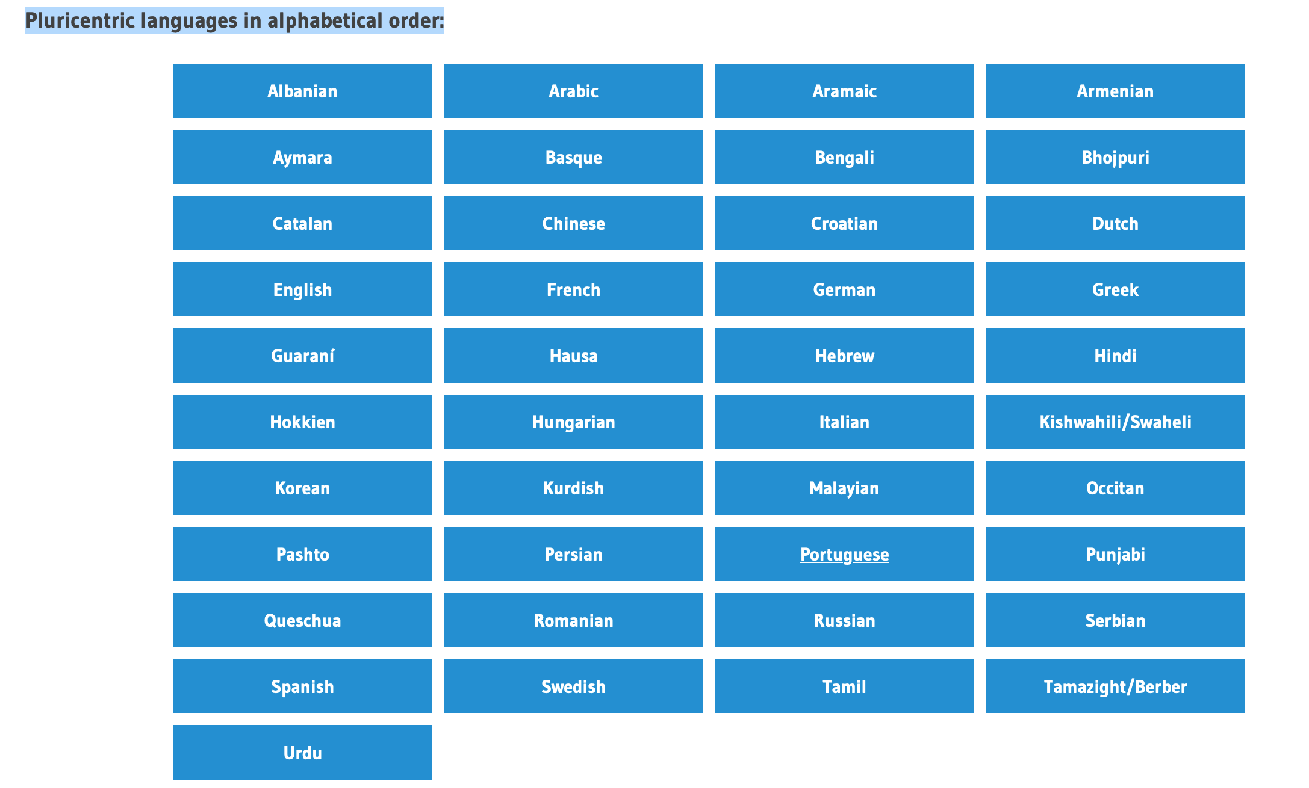
In 2018 fourty one languages can be considered as pluricentric in the wider sense of fulfilling at least formally the criteria of being 'pluricentric'. They result in about 290 national varieties which differ in one way or other. (Cf. http://www.pluricentriclanguages.org/plc-languages)
Tamil
Varieties
Sri Lankan Tamil (Data to be supplied)
Indian Tamil (Data to be supplied)

Slide 12
General attitude of the Diaspora population over retaining language in Diaspora regions. (A parent’s opinion during the workshop on teaching Tamil in the USA)
Kids/parents are not interested to learn grammar. They want to mainly focus on speaking and reading. How can we address the issue?
Please provide suggestions for getting kids to read and speak fluently.
Would like to understand how to keep the little kids engaged through the class as their attention span would be very less.

Slide 13
Tamil as a common unifier irrespective of its dialect variation, which is fundamentally a divider
Among the several nationalist discourses in India the religious
discourse of Shaiva Siddhanta, which called for a return to the worship
of Shiva through the medium of Tamil as a ‘pure’ and divine language
(Ramaswamy 1993, Sivathamby 1984, Pfaffenberger 1994) became
of particular importance in Jaffna. Suseendirarajah (1980) has observed
that when she asked villagers in Jaffna what their religion was, they
answered ‘Tamil’. To them their religion could not be conceptually
separated from their language – ‘Tamil language and Saivism are ...
for them two sides of the same coin’ (p. 347). (Cf. Life on the Outside the Tamil Diaspora and Long-Distance Nationalizm (Anthropology, Culture and Society) by Ivind Fuglerud, Oivind Fuglerud, London, Pluto Press (1999)).

Slide 14
Which dialect exhibits more features of Sangam Tamil? - A question toward claiming Tamil identity!
According to Kamil Zvelebil the Batticaloa Tamil dialect is the most literary like of all spoken dialects of Tamil, and it has preserved several very antique features, and has remained more true to the literary norm than any other form of Tamil while developing a few striking innovations. (Zvelebil, Kamil (June 1966). "Some features of Ceylon Tamil". Indo-Iranian Journal. 9 (2): 113–138. )

Slide 15
Which dialect is is the closest to the literary variety? - A claim for identity domination.
Ravi commented that Batticaloa Tamil, and not Jaffna Tamil, is the “best” Tamil, as it is closest to the literary variety enacting a similar ideology to Rajani in example one, his statement assumes that the variety that is closest to the literary variety is the “best. ”Geetha, also refuting the view that Jaffna Tamil is the “best,” added that you cannot say that one kind of spoken Tamil is better than another as each has its place in the Tamil language.
(Davis, Christina, “Is Jaffna Tamil the Best?” Producing “Legitimate” Language in a Multilingual Sri Lankan School – Journal of Linguistic Anthropology, 2012, Vol. 2)

Slide 16
Regional vs. Social Dialect
The second largest minority group is Muslims, some of whom are descendants of Arab traders who settled on the island 900 years ago; and others who are descendants of Indian traders of more recent origin (Little 2003)
Though the majority of Muslims speak Tamil as a first language, they identify as a separate ethno-religious group (Nuhman 2007)

Slide 17
Classical Tamil with grammatical features from the vernacular language of Jaffna Tamil elites – An attempt to make a Classical Literary variety out of a vernacular variety – Jaffna Tamil.
In early 20th-century Jaffna, an early version of a Sri Lankan Tamil literary “standard” was compiled by Tamil nationalist leaders by putting together stylistic features from the poetic genre of classical Tamil with grammatical features from the vernacular language of Jaffna Tamil elites (2008).
As Das writes, “This standardization effort prompted the formation of a coeval chronotype linking together the region, people, and languages of pre-historic Indian Tamilagam (circa 300 B.C.E to C.E. 300), the pre-colonial Jaffna kingdom (circa 13th– 17th centuries), the contemporary Jaffna peninsula, and the projected Tamil Eelam”(2008:5). Genres of literary (ilakkiya) or pure Tamil (centamizh) were then ideologically contrasted with the everyday language of communication, which was considered to be corrupt (kochai) (Das 2008)
(Cf. Davis, Christina, “Is Jaffna Tamil the Best?” Producing “Legitimate” Language in a Multilingual Sri Lankan School – Journal of Linguistic Anthropology, 2012, Vol. 2 P.65)

Slide 18
Attempt toward making a Plucentric variety out of vernacular spoken variety and Classical Variety
Jaffna/Baticola Dialects are much closer to Classical Tamil than any other dialects of Tamil, including the dialects of Tamilnadu.
Affirming that the Jaffna Tamil IS the literary Classical Tamil Variety
Plucentric variety of Srilankan Tamil Variety is THE variety of Tamil comprising both vernacular and classical varieties of Tamil.
→Covert definition that one can derive for the Status of Srilankan Tamil Variety is that
Plucentric Variety of Tamil can emerge provided a corresponding literary variety is derived out of the Spoken informal variety, so they both can act as contenders to the respective varieties spoken in the mainland.

Slide 19
THANKS

