Slide 1
The Future of Tamil Diaspora
Vasu Renganathan
University of Pennsylvania
International Conference: Indian Languages in Diasporas – Strategies of Retention and Modes of Transmission
29-31 Oct. 2015, Mémorial ACTe, Pointe-à-Pitre, Guadeloupe

Slide 2
Four major types of Tamil Heritage/Diaspora Learners
Type I – True HLL (fluent in speech and comprehension)
Type II – Single-Track HLL (fluent in comprehension but not in speech)
Type III – Passive HLL (relatively less skill in comprehension)
Type IV – Fall-back HLL (almost like TLL – born to Tamil parents)
four types of activities to be proposed as part of the process of designing differential curriculum in Tamil.

Slide 3
HLL, TBL and Differentiated Curriculum
Challenges involving language education for heritage learners:
how can we distinguish between HLL and TBL based on their linguistic profiles?
how can one design a differentiated curriculum that could fit the needs of both types of learners at any given classroom?

Slide 4
Heritage Language Environment
Heritage learners are challenged too much or too less than they are capable of …
As the linguistic profiles of each of the HLLs mostly show a personalized HL environment at home, community, or any other linguistic circles.
One is not in a position to define any single type of target language speech context as the typical language acquisition environment for Diaspora population.

Slide 5
Differentiated Instruction
Differentiated instruction is a teaching theory based on the premise that instructional approaches should vary and be adapted in relation to individual and diverse students in classrooms (Tomlinson, 2001).
Normally, differentiated instruction is focused upon four different aspects of language learning contexts namely content (lessons), process (activities), product (demonstration) and learning environment (classroom environment) and each of these categories needs to be formulated keeping in mind the proficiency levels of each participating student.

Slide 6
Heritage Learner
“All definitions can be said to be valid for particular communities in the U.S. and to be of value for specific linguistic tasks (i.e. teaching, linguistic maintenance, revival, etc). However, no sole definition is capable of embracing all and only such individuals that could conceivably be argued to fall under the heading of “heritage language learner” (Carreira 2004).
--No single trait can be attributed to HLE

Slide 7
study
A set of heritage Tamil students belonging to
--university as well as high school levels
--heritage Tamil family members
--questions relevant to identify the Tamil language speech context in their home and community
--motivation levels of students as well as parents.

Slide 8
Formalization of Language
learning a formal grammar and knowing the formal variety of Tamil do not show any impact upon their language use and acquisition unless they are trained to specifically unlearn their informal knowledge of Tamil that they learned from social contexts and subsequently learn to negotiate between spoken and written variety, a process that can be termed as ‘formalization of the knowledge of heritage learners’ (Renganathan, 2008).

Slide 9
Fossilized Slangs acquired at home
puṭṭukka pōvudu ‘might break’ appramēlu ‘afterwards’ ikkkunōṇḍu ‘tiny bit’ vantākkā ‘if one arrives...’ eppāccum ‘occasionally’ ennatte colla? ‘what to say?’ varumāṭṭrukku 'it appears as though s.t. might arrive'

Slide 10
Occasional Immersion leads to occasional fluency, but the mono-lingual routine ruins it!
“… every three years, we go for a six-week long vacations to India where I was forced to speak in basic Tamil to my large extended family – many of whom did not know any English. My exposure to Tamil increased dramatically as well. At the end of every trip, (especially those taken when I was younger than 12 years of age) my spoken Tamil fluency increased somewhat noticeably by the end of the trip. However, I would quickly return to my previous level of Tamil proficiency after being back in the US and falling back into the normal routine of solely using English in school and at home.” (HL student, Ramasamy).

Slide 11
Occasional Formal Instruction
"... During the second semester, I learned basic grammar and improved my reading skills. Reading stories was difficult since my vocabulary is somewhat limited. Also, many of the words used were entirely different from the words used in spoken Tamil. Learning simple tenses in both spoken and written forms was confusing at times, but ultimately, learning each tense has laid the groundwork for me to be able to understand Tamil speech better. Having to distinguish between very different written and colloquial Tamil creates much confusion." (HL Tamil student Ramasamy).

Slide 12
Different Categories of HLLs
Valdés (1997:14) posits for Spanish HLLs eight different categories that reflect the diversity of background and linguistic experiences of U.S. Latinos. At one end of this classification are the fluent speakers of a prestigious variety of Spanish while at the other end are those who have only receptive skills in a contact variety of rural Spanish.

Slide 13
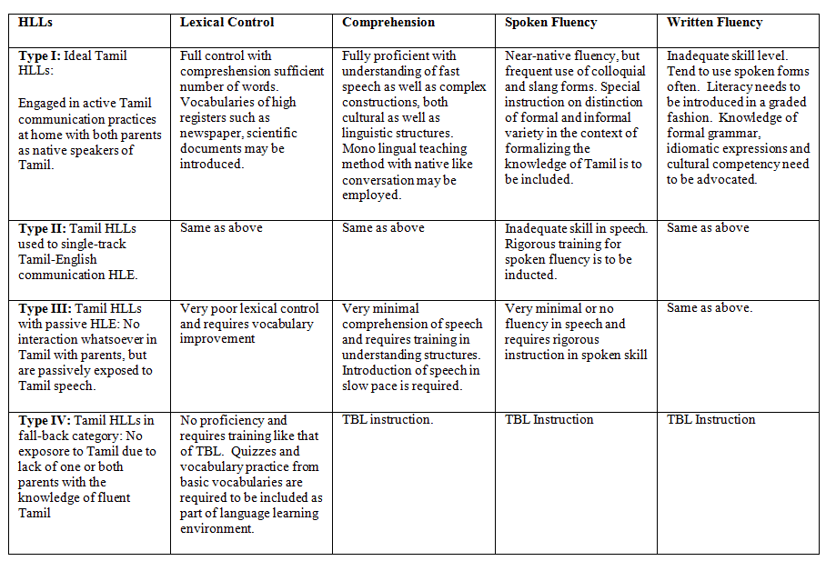
Differentiated Curriculum for Heritage Learners of Tamil

Slide 14
Thank you!

