Slide 1
Tamil Poet-Saints' Perceptions and the Saiva Temple Architectures in Tamil Nadu
Vasu Renganathan University of Pennsylvania

Slide 2
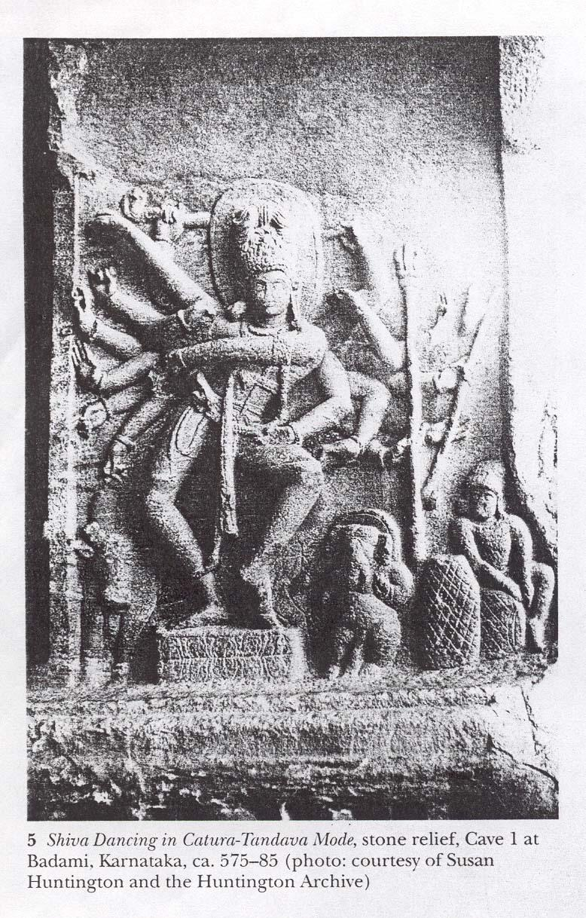
Dancing Siva without the Dwarf under the feet. Courtesy: Kaimal (1999: 394)

Slide 3
Tirumantiram: 2724
Upon the glory of the endless Sakthi, Experience the engaging blissful dance! Transcending all of the knowledge, dances the Lord! The space thus becomes the locution for dance!

Slide 4
Tirumantiram: 2724
None experiences the Lord within! Of all the eight directions, glorify Him as God! Surpassing the Cosmos, remains the blissful dancer! None experiences His face within the devotee’s heart!

Slide 5
Paranjothi – Tiruvilaiyadar puranam 456:2
“We perform that dance,
in this VeLLiyambalam (Madurai)”, Said the Lord.
“The World is nothing but a Human Form!
Heart is the Ponnambalam (Chidambaram) and
Top of head is this VeLLiyambalam”,
proclaimed the Lord gracefully.
Oh! The Lord! “What are the other parts then?”
The Saints Wonder!
The Lord Proclaims further!
World is the human body, so to say!
There exists a limitless Sanctorum on this earth!
To describe them all, impossible it would be!
We explain some, all of you listen!.

Slide 6
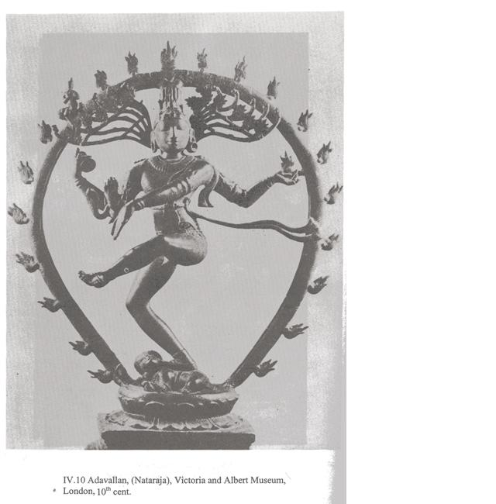

Slide 7
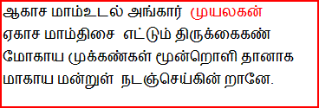
Tirumantiram: 2774
His body pervades the space! Darkness in space is Muyalaka the Demon Spreads are His hands permeating the space Charming are His eyes, the Sun, Moon and Fire! Thus He dances in a Stage of the Sky!

Slide 8
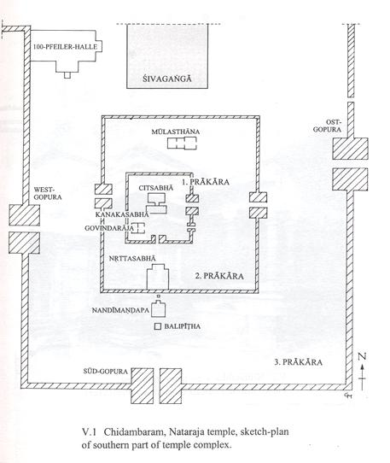
Ground Plan of the Chidambaram Nataraja’s Temple
Courtesy: Nagaswamy (2002)

Slide 9
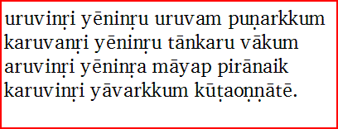
Chidambara Rahasyam
Tirumantiram: 2840
Form, He has none; He becomes all of the Forms.
Cosmic Egg, He has none; He is the Cosmic Egg.
Him, the elusive Lord without a Form,
Impossible for anyone to reach,
Without His essence - the karu.

